Slide 1
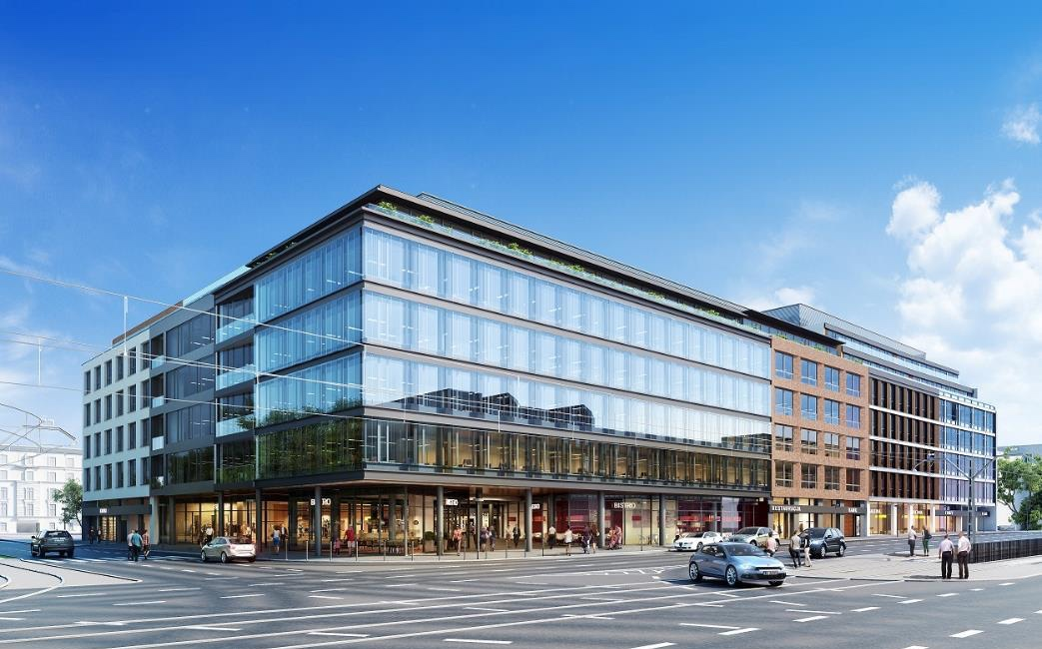
Lead pic.
Notes:
Welcome!

Slide 2
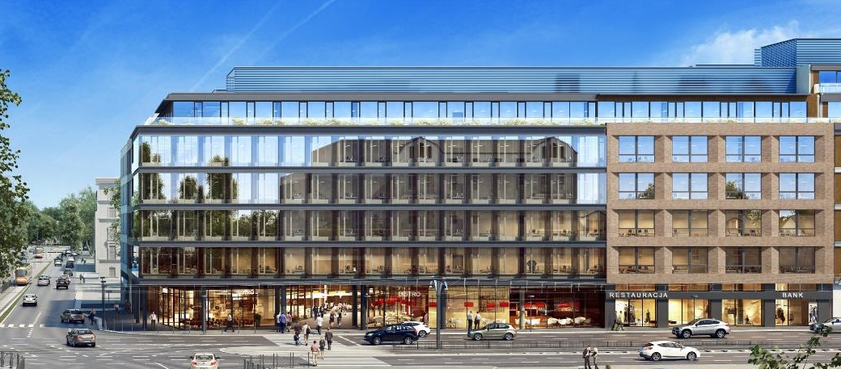
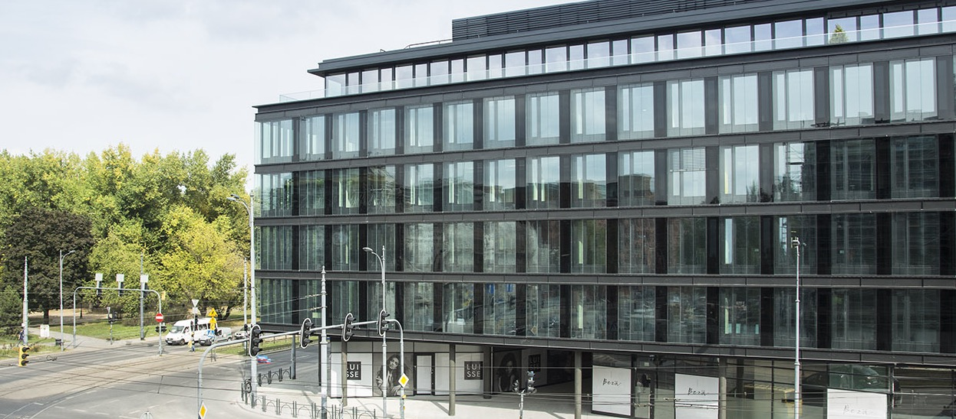
Łódź
Ogrodowa Office
High res. pic.
Current rendering
Office building next to andel‘s hotel Łódź – premium location in the city
Total of approx. 27,400 m² lettable office space – 40 % pre-leased
Underground parking lot
Construction started in Q4 2016
Opened October 2018
Notes:
Construction is progressing nicely for the Ogrodowa office building in the Polish city of Łódź. An LOI for 40 % of the office space has already been signed.

Slide 3
Company history
1959
2009-2014
Foundation of Warimpex Export-,
Import- Transithandelswarengesellschaft m.b.H.
Hotel andel’s, Łódź
Hotel angelo, Katowice
Hotel andel`s, Berlin
Hotel angelo, Bucharest
Hotel angelo, Ekaterinburg
Hotel Crowne Plaza, AIRPORTCITY St. Petersburg
Le Palais Office, Warsaw
Jupiter Towers, AIRPORTCITY St. Petersburg
Palais Hansen Kempinski, Vienna
1980
Warimpex enters real estate market
1982 - 1988
Novotel, Budapest – first Warimpex hotel
Penta Hotel, Budapest, Forum Hotel, Prague
1988-1989
Holiday Inn, Warsaw
Hotel Palace, Prague
1994 -1996
Hotel Savoy, Prague
Hotel Sheraton, Warsaw
Warsaw Towers – first Warimpex office building
1999
2015-2018
2001-2003
Shopping and Entertainment Gallery, Brno
Hotel andel’s, Prague
Hotel Le Palais, Prague
Hotel InterContinental, Warsaw
Zeppelin Tower, AIRPORTCITY St. Petersburg
Erzsébet Office, Budapest
Bykovskaya multi-use building, AIRPORTCITY
St. Petersburg
B52, Budapest
Ogrodowa office, Lodz
2004-2006
andel’s Suites, Prague - long stay apartments
Leaders Club guests recognition Award for Le Palais
Hotel angelo, Prague
Hotel Chopin, Krakow
Hotel Sobieski, Warsaw
2007-2008
IPO in Vienna and Warsaw
Hotel andel‘s, Krakow
Hotel Liner, Ekaterinburg
Hotel angelo, Munich
Hotel angelo, Pilsen

Slide 4
Real estate held by sector*
* Gross Asset Value as of 31.12.2017 (31.12.2016)
Notes:
Total GAV 202.5 M

Slide 5
Real estate assets by country*
* as of 30.06.2018

Slide 6
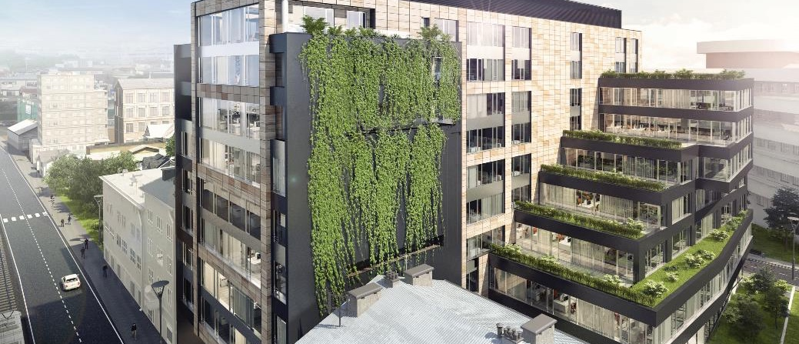
Krakow
Mogilska 43
High res pic
Office building in the commercial district
Total of approx. 12,000 m² lettable office space
60 % pre-leased
Underground parking lot
Construction started in Q3 2017
Expected opening in Q1 2019
Notes:
The same applies to the Mogilska office building in Krakow. Construction has already started and a long-term lease agreement has been signed for 60 % of the space.

Slide 7
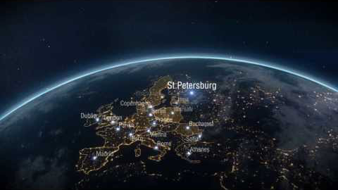
Notes:
We set a milestone in the history of our company with the sale of eight hotel holdings to the Thai investor U City at the end of May. This transaction allowed us to accomplish something in one fell swoop that had not been possible at a sufficient return during the economically challenging previous years.

Slide 8
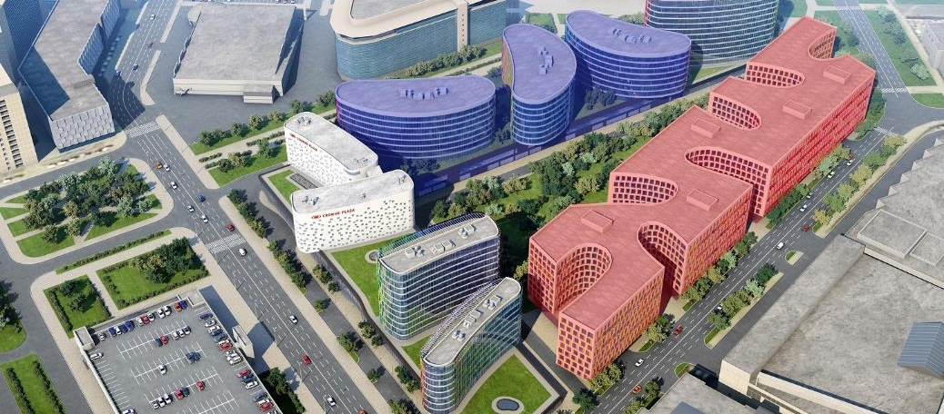
AIRPORTCITY St. Petersburg
Phase III & IV
Phase III offices – approx. 20,000 m² lettable office space
Early planning stage
Expected opening in 2021
Phase IV offices – approx. 130,000 m² lettable office space
Early planning stage
Expected opening in 2025
Notes:
We also hold property reserves for around 150,000 square metres of office space at the site.

Slide 9
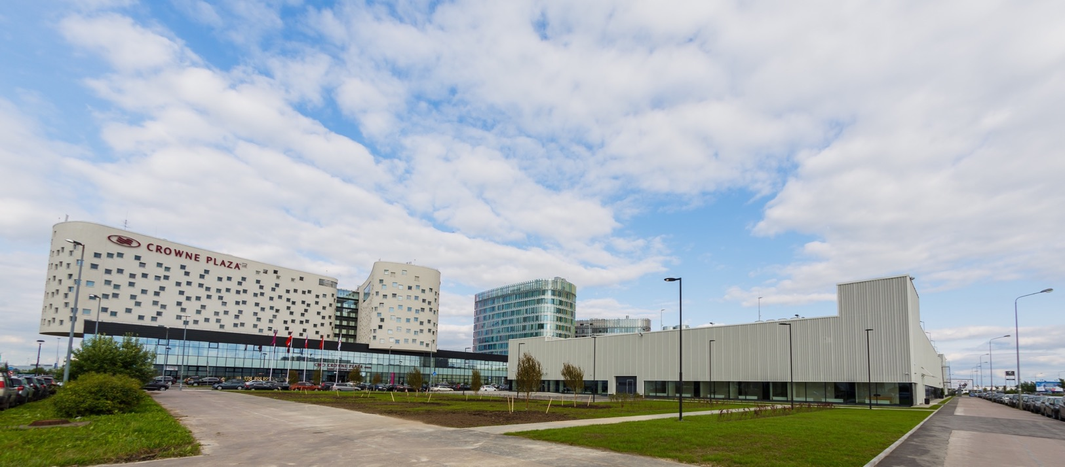
2017: AIRPORTCITY St. Petersburg
Bykovskaya multi-use building
3 car parking decks with 450 car parking spaces and bus parking spaces
2,500 m² archive / storage area
4,700 m² office space
Car wash station, car service station
Fully let
Finished and handed over to tenant in May 2017
Notes:
At AIRPORTCITY St. Petersburg, we completed the fully occupied Bykovskaya multi-use building and handed it over to the tenant in the spring of 2017.

Slide 10
Operational Highlights
Purchase and sale of properties in Budapest
Acquisition of B52 Office
Sale of Ülloi land plot
Ogrodowa Office in Lodz opened
Notes:
We set a milestone in the history of our company with the sale of eight hotel holdings to the Thai investor U City at the end of May. This transaction allowed us to accomplish something in one fell swoop that had not been possible at a sufficient return during the economically challenging previous years.

Slide 11
Key figures
Revenues: -48 % to EUR 14.4 mn
Revenues Hotels -70 %
Revenues Investment Properties +24%
EBITDA / EBIT: EUR 2.9 mn / EUR 2.7 mn
Gross Asset Value + 12 %
Net Asset Value EUR 2.4 per share

Slide 12

Developments
Notes:
The proceeds from the portfolio sale will allow us to launch new real estate projects and thus achieve organic growth as well as to quickly complete our current developments.

Slide 13
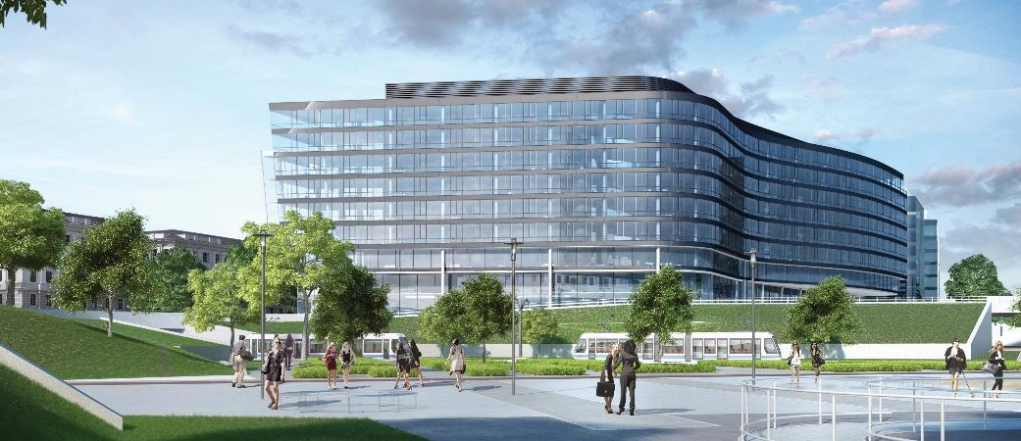
Krakow
Chopin Office
High res. pic.
Office building next to Chopin hotel Krakow
Premium location in the city
Total of approx. 21,000 m² lettable office space
Underground parking lot
Planning stage
Expected opening in 2021
Notes:
Also in Krakow, we are planning the construction of an office building with around 26,000 square metres of total space on a development property next to the Chopin Hotel.

Slide 14
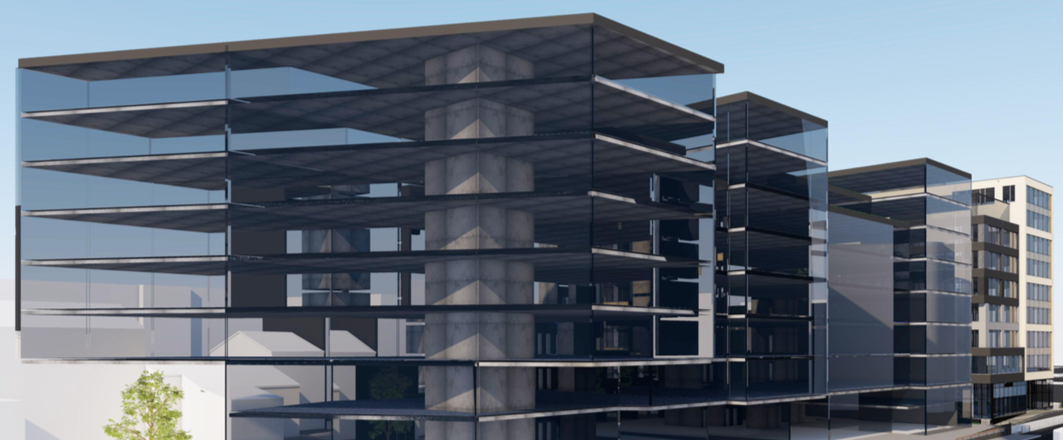
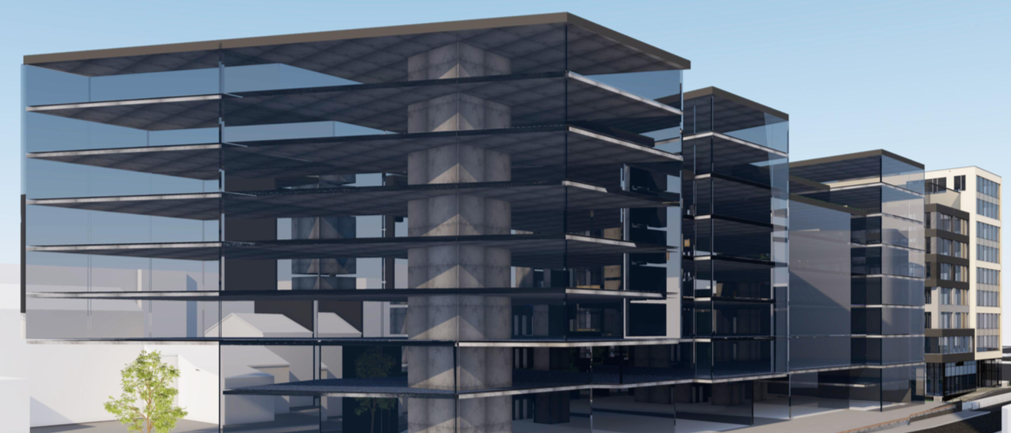
Krakow
Mogilska 41
Office building in the commercial district
Total of approx. 12,000 m² lettable office space
Underground parking lot
Expected opening in 2021
Notes:
The same applies to the Mogilska office building in Krakow. Construction has already started and a long-term lease agreement has been signed for 60 % of the space.

Slide 15
Białystok
Offices
Development plot for 4 office buildings
Total area of approx. 73,000 m²
Early planning stage
Notes:
In Białystok, we own a building plot that was expanded through the purchase of adjacent lots during the reporting period. Four office properties will be built on this site in multiple phases.

Slide 16
Overview developments
Project | Status | Exp. opening | Total area (approx.) | Beneficial ownership
AIRPORTCITY St. Petersburg Bykovskaya multi-use building | finished | Q2 2017 | 7,200 m² 450 parking spaces | 100 %
Łódź Ogrodowa Office | finished | Q4 2018 | 27,400 m² | 100 %
Krakow Mogilska 43 | construction | Q1 2019 | 12,000 m² | 100 %
Krakow Chopin Office | planning | 2021 | 21,000 m² | 100 %
AIRPORTCITY St. Petersburg Offices phase III | planning | 2021 | 20,000 m² | 55 %
Białystok Offices phase 1 | early planning | 2021 | 13,000 m² | 100 %
Krakow Mogilska 41 | early planning | 2021 | 12,000 m² | 100 %
Białystok Offices phase 2-4 | early planning | - | 60,000 m² | 100 %
AIRPORTCITY St. Petersburg Offices phase IV | early planning | - | 130,000 m² | 55 %
Notes:
Currently, there are 9 development projects in our pipeline – some of them already quite advanced, others still in the planning stage.

Slide 17

Transactions & Acquisitions
Notes:
Let me now give you a short overview on our transactions and acquisitions in 2017.

Slide 18
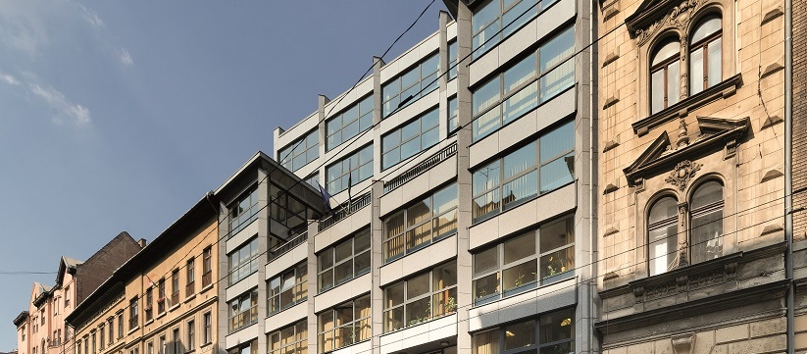
2018: Budapest
Acquisition of B52 Office in May 2018
Class A office building in the heart of the Pest area
Lettable office space of more than 5,200 m²
Flexible office layouts spread out over seven upper floors and a ground floor
26 parking spaces
100 % let out
Notes:
In April 2018 – after the reporting date – we acquired the fully occupied B52 office building in Budapest.
In early March, we signed a contract for the sale of the development property in Budapest, where we were planning a hotel with adjacent apartments. The closing is scheduled for May 2018.

Slide 19
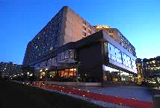
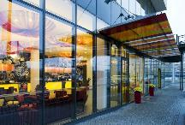
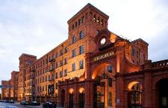
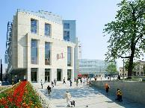
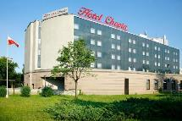
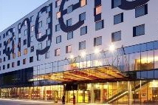
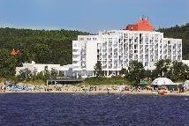
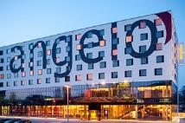
2017: Sale of 8 hotel holdings in
3 countries
andel‘s
by Vienna House
Łódź, PL
Vienna House
Diplomat
Prague, CZ
andel‘s
by Vienna House
Krakow, PL
angelo
by Vienna House
Pilsen, CZ
Vienna House
Amber Baltic
Międzyzdroje, PL
angelo
by Vienna House
Katowice, PL
angelo
by Vienna House
Bucharest, RO
Vienna House
Easy Chopin
Krakow, PL
Notes:
This overview shows which hotel holdings were sold to U City in May 2017.
In addition to this transaction, we concluded several smaller but no less important deals.
We purchased the remaining shares in the Bykovskaya multi-use building in St. Petersburg, so the building is now fully owned by the Group.

Slide 20

Key to future success

Slide 21
Three key objectives for 2018/19
1.
new developments
2.
strategic acquisitions
3.
dividend
payment
portfolio growth up to
pre-portfolio-sale-level
by end of 2019
Notes:
The excellent results 2017 will allow Warimpex to implement three key objectives:
new developments that are already under construction or in the planning stage,
strategic acquisitions in order to quickly return to a solid level of cash flows
→ We plan to reach the same portfolio volume we had before the sale of the hotel holdings by the end of 2019 through selective purchases and construction progress.
3. and a commensurate dividend of EUR 0.06 that we plan to propose at the coming Annual General Meeting.
We will continue to focus on diversifying our markets and our portfolio in the future, as this strategy has proven very successful up to now.

Slide 22
Lead pic.
Thank you!

Slide 23
Appendix

Slide 24
Income statement – 1-6 2018
EUR (in thousands) | 1-6 2018 | 1-6 2017 | +/-
Revenues from Hotels | 6,296 | 20,786 | -70 %
Revenues from Investment Properties | 7,506 | 6,053 | 24 %
Revenues from Development & Services | 597 | 665 | -10 %
Total revenues | 14,399 | 27,505 | -48 %
Expenses directly attributable to the revenues | -6,317 | -15,406 | -59 %
Gross income from revenues | 8,082 | 12,099 | -33 %
Income from the disposal of properties | - | 23,624 | -
EBITDA | 2,892 | 29,452 | -90 %
Depreciation, amortization, and revaluation | -145 | 13,901 | -
EBIT | 2,747 | 43,353 | -94 %
Financial result | -7,226 | -9,216 | -22 %
Profit/Loss for the period | -4,263 | 33,547 | -
Profit/Loss for the shareholders of the parent company | -2,461 | 28,716 | -

Slide 25
Balance Sheet – 30 June 2018
EUR (in thousand) | 30/6/2018 | 30/6/2017 | +/-
Non-current Assets | 247,399 | 191,566 | 29 %
Current Assets | 17,248 | 64,369 | -73 %
Total Assets | 264,648 | 255,935 | 3 %
Equity attributable to shareholders of the parent | 103,964 | 100,649 | 3 %
Non-controlling interests | -29,363 | -22,645 | 30 %
Equity | 74,601 | 78,004 | -4 %
Long-term Debt | 159,983 | 129,727 | 23 %
Short-term Debt | 30,063 | 48,204 | -37 %
Total Equity and Liabilities | 264,648 | 255,935 | 3 %

Slide 26
Cash flow statement – 1-6 2018
EUR (in thousand) | 1-6 2018 | 1-6 2017 | +/-
Cash receipts | 14,567 | 28,117 | -48 %
Cash payments | -13,933 | -23,665 | -41 %
Cash flows from operating activities | 634 | 4,452 | -
Cash flows from investing activities | -14,163 | 64,702 | -
Cash flows from financing activities | 1,587 | -27,844 | -
Cash and cash equivalents at the end of period | 10,475 | 45,997 | -77 %

Slide 27
Income statement – FY 2017
EUR (in thousands) | 1-12 2017 | 1-12 2016 | +/-
Revenues from Hotels | 27,509 | 51,864 | -47 %
Revenues from Investment Properties | 13,190 | 8,580 | 54 %
Revenues from Development & Services | 1,668 | 1,757 | -5 %
Total revenues | 42,367 | 62,201 | -32 %
Expenses directly attributable to the revenues | -21,995 | -35,967 | -39 %
Gross income from revenues | 20,412 | 26,235 | -22 %
Income from the disposal of properties | 26,575 | 8,674 | 206 %
EBITDA | 33,605 | 21,450 | 57 %
Depreciation, amortization, and revaluation | 21,098 | 4,285 | 392 %
EBIT | 54,704 | 25,735 | 113 %
Financial result | -11,715 | -1,889 | 520 %
Profit for the period | 40,496 | 22,862 | 77 %
Profit for the shareholders of the parent company | 40,542 | 17,423 | 133 %

Slide 28
Balance Sheet – 31- Dec. 2017
EUR (in thousand) | 31/12/2017 | 31/12/2016 | +/-
Non-Current Assets | 223,272 | 174,185 | 28 %
Current Assets | 41,982 | 183,701 | -77 %
Total Assets | 265,254 | 357,886 | -26 %
Equity attributable to shareholders of the parent | 110,926 | 70,188 | 58 %
Non-controlling interests | -27,445 | -27,130 | -
Equity | 83,481 | 43,058 | 94 %
Long-term Debt | 154,300 | 169,371 | -9 %
Short-term Debt | 26,468 | 145,457 | -82 %
Total Equity and Liabilities | 265,254 | 357,886 | -26 %

Slide 29
Cash flow statement – FY 2017
EUR (in thousand) | 1-12 2017 | 1-12 2016 | +/-
Cash receipts | 46,347 | 64,370 | -28 %
Cash payments | -34,345 | -51,412 | -33 %
Cash flow from operating activities | 12,002 | 12,958 | -7 %
Cash flow from investing activities | 48,081 | 10,121 | 375 %
Cash flow from financing activities | -41,939 | -26,751 | 57 %
Cash and cash equivalents at the end of period | 22,849 | 4,723 | 384 %

Slide 30
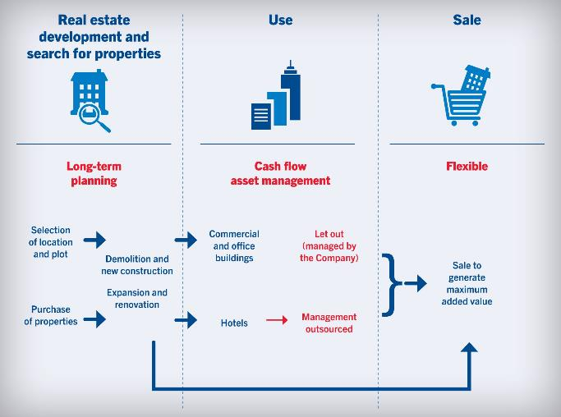
Long-term and flexible corporate strategy
Notes:
All of these positive developments confirm the viability of our corporate strategy, which is based on a long-term and flexible approach: to develop hotel and office properties and hold them in our portfolio until the time at which the highest added value can be realised through sale.
The issues of sustainability and CSR are also important to us. After all, the Warimpex Group’s real estate development projects and the operation of its properties have an impact on the social, ecological, and economic environments in which it does business. Because of this, the Company bears great responsibility. We have firmly anchored the fulfilment of this responsibility into our corporate culture, and see living up to this responsibility as a central element in our success. With this in mind, we are pleased that this report marks the first time that we have provided more detailed information in this regard.

Slide 31
Current hotel portfolio at a glance
Hotels | City | Country | Rooms | Stake
Vienna House Dvorak**** | Karlovy Vary | CZ | 126 | 100 % operating lease
InterContinental***** | Warsaw | PO | 404 | 50 % operating lease
Crowne Plaza**** | St. Petersburg | RU | 294 | 55 %
Vienna House Dream Castle**** | Paris | FR | 397 | 50 %
Vienna House Magic Circus**** | Paris | FR | 396 | 50 %
Palais Hansen Kempinski Wien***** | Vienna | AT | 152 | 9.88 %
as of 30.06.2018

Slide 32
Current office portfolio at a glance
Offices | City | Country | Area | Stake | Occ. rate (approx.) | Tenant
Business Tower Zeppelin | St. Petersburg | RU | 15,600 m² | 55 % | 100 % | Gazprom
Business Tower Jupiter | St. Petersburg | RU | 17,000 m² | 24 % | 100 % | Gazprom
Bykovskaya multi-use building | St. Petersburg | RU | 6,000 m² | 100 % | 100 % | Gazprom
Erzsébet Offices | Budapest | HU | 15,000 m² | 100 % | 95 % | Groupama Garancia Insurance
Sajka Office | Budapest | HU | 600 m² | 100 % | 100 % | several
B52 | Budapest | HU | 5,200 m² | 100 % | 100 % | several
Mogilska 41 | Krakow | PL | 5,800 m² | 100 % | 100 % | Air Liquide / Lurgi
as of 30.06.2018

Slide 33
Warimpex on the stock exchange
Key Exchange Data
Number of shares | 54,000,000
Vienna Stock Exchange | ATX Prime, Immobilien-ATX
Warsaw Stock Exchange | Market Main 50 Plus, WIG SWIG80
Ticker Symbols | Stock Exchanges WXF Reuters WXFB.VI
Shareholder structure
Franz Jurkowitsch
14 %
Georg Folian
15 %
Free Float
44 %
Amber Privatstiftung
11 %
MetLife PTE
> 5 %
Bocca Privatstiftung
11 %

Slide 34
Over 30 years experience
Hotels | Number of rooms | In portfolio since | Sale
Palace Hotel, Prague | 5-star, 124 rooms | purchased 2001 | 2013
angelo Hotel, Munich | 4-star, 146 rooms | opened 2008 | 2013
InterContinental, Warsaw | 5-star, 414 rooms | opened 2003 | 2012
Sobieski Hotel, Warsaw | 4-star, 435 rooms | purchased 2006 | 2011
andel‘s, Krakow | 4-star, 159 rooms | opened 2007 | 2009
andel‘s Hotel & Suites, Prague | 4-star, 239 rooms + 51 studios | opened 2002 | 2005
Sheraton Hotel, Warsaw | 5-star, 350 rooms | opened 1996 | 1996
Pruhonic Sport Hotel, Prague | 4-star, 100 rooms | opened 1990 | 1990
Holiday Inn, Warsaw | 4-star, 172 rooms |  | developed 1989
Forum Hotel, Prague | 4-star, 560 rooms |  | developed 1989
Jelina Gora Hotel, Jelina Gora | 4-star, 172 rooms |  | developed 1989
Panorma Hotel, Prague | 4-star, 456 rooms |  | developed 1983
Novotel Hotel, Budapest | 4-star, 324 rooms |  | developed 1982
Penta Hotel, Budapest | 4-star, 400 rooms |  | developed 1982
Offices | Area (sqm) | In portfolio since | Sale
Jupiter Towers 1+2, St. Petersburg | 17,000 sqm | opened 2011/2012 | 2015
Csalogany Office, Budapest | 2,600 sqm | purchased 2003 | 2009
Pauler Office, Budapest | 3,000 sqm | purchased 2006 | 2008
andel‘s City SO 11, Prague | 4,000 sqm | opened 2007 | 2007
Warsaw Towers, Warsaw | 20,000 sqm | opened 1999 | 2000

Slide 35
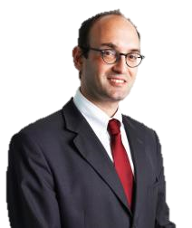
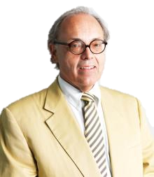
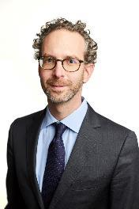
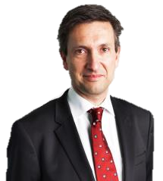
Management Board of Warimpex
Alexander Jurkowitsch Franz Jurkowitsch Daniel Folian Florian Petrowsky Member Chairman Deputy Chairman Member

Slide 36
Corporate calendar
30 November 2018 Publication of the results for the first three quarters of 2018
26 April 2019 Publication of the annual report 2018
24 May 2019 Record date
28 May 2019 Publication of the results for the first quarter of 2019
3 June 2019 Annual General Meeting
6 June 2019 Ex-dividend date
7 June 2019 Dividend record date
12 June 2019 Dividend payment date
27 August 2018 Publication of the results for the first half of 2019
29 November 2018 Publication of the results for the first three quarters of 2019

Slide 37
Contact details
Franz Jurkowitsch
Chairman
Tel.: +43 1 310 55 00 – 125
franz.jurkowitsch@warimpex.com
Daniel Folian
CFO, Investor Relations
Tel.: +43 1 310 55 00 – 156
daniel.folian@warimpex.com
Christoph Salzer
Prokurist, Media Relations
Tel.: +43 1 310 55 00 – 143
presse@warimpex.com

