Slide 1
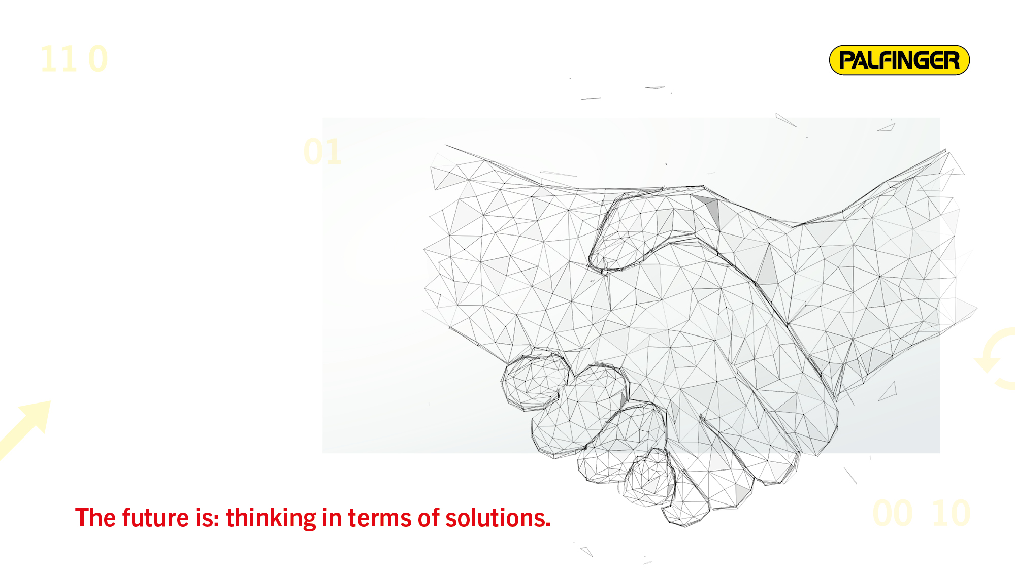
PALFINGER
Continuation of growth
Presentation on the results
for the first half of 2018
Luxembourg, 25 October 2018

Slide 2


THE PALFINGER GROUP – AN OVERVIEW
Global market leader
Revenue: approx. EUR 1.5bn, 10,212 employees (year end 2017)
  39 production sites
60.9% EMEA – 23.6% Americas – 15.5% Asia and Pacific, CIS
LAND: approx. EUR 1.2bn
  8,200 employees
  5,000 service centres worldwide
  Global market leader for loader cranes, hooklifts and skiploaders, timber and recycling cranes, and railway systems
  Top 3 worldwide for tail lifts and truck mounted forklifts
SEA: approx. EUR 0.2bn
  1,700 employees
  26 service centres worldwide
  Global market leader for lifesaving equipment
  Leading position in cranes for ships, offshore installations and offshore wind farms
World’s leading supplier of loading, lifting and handling systems
2

Slide 3
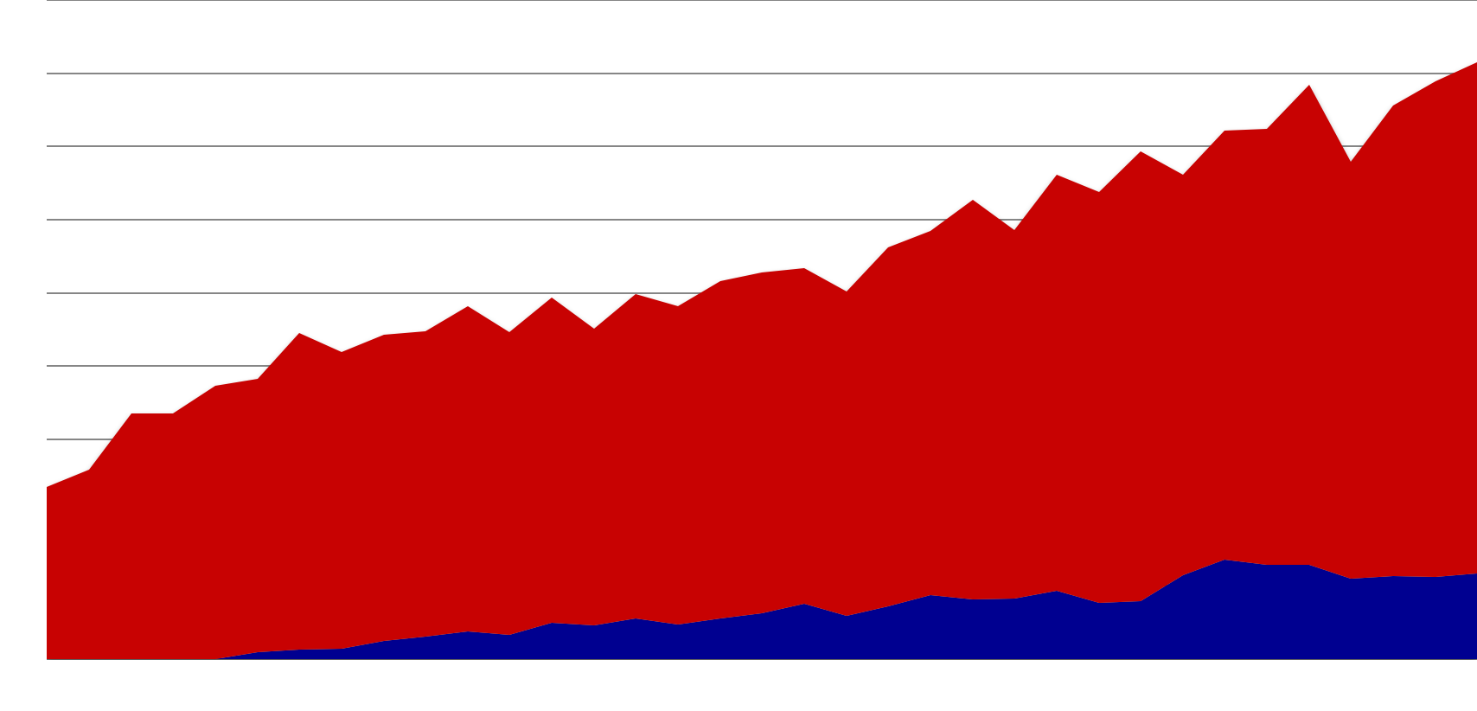
CONSISTENT GROWTH – ORGANIC AND THROUGH ACQUISITIONS
LAND segment from Q4 2009 to Q2 2018: +197%
SEA segment from Q1 2011 to Q2 2018: +1,174%
Quarterly revenue
400
Total revenue
+191.1% 2009–2017
CAGR: 14.3%¹⁾
EUR 349.2m
300
2010 to 2017
24 acquisitions and joint ventures
200
EUR 117.5m
JV SANY
Dreggen
Palfinger-Tercek
PCR
MCT
JV Platforms Italy
JV Koch
PPI
Nimet
JV KAMAZ
PM Group
Hidro-Grubert
Megarme
Harding
Palfinger Iberica
Sky Steel Systems
Palfinger Danmark
NDM
JV FairWind
JV KAMAZ
ETI
Ned-Deck Marine
Marine cranes
EUR 58.5m
Q1 2011
EUR 4.6m
INMAN
2010
2011
2012
2013
2014
2015
2016
2017
1) of which 55% organic; 45% inorganic
3

Slide 4
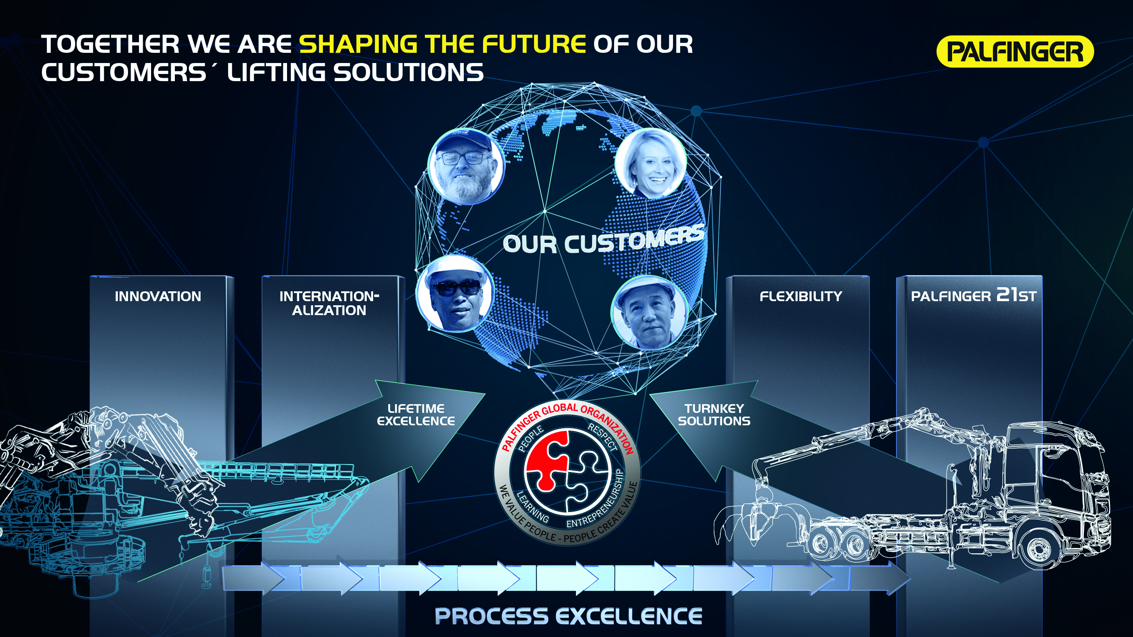

Slide 5
HIGHLIGHTS HY1 2018
Revenue of EUR 801.9m (+6.4%) marks new peak, operating profitability (measured by EBITn) in the double-digit range again
Primarily organic expansion of business, mainly caused by positive development in Europe and CIS
Marine business still highly challenging
Restructuring in North America (completed to a major extent) and in the marine business had a negative impact on earnings
Continuously high order backlog
Management team complete again since 1 June 2018
5

Slide 6
LAND SEGMENT
6

Slide 7



PRODUCT PORTFOLIO LAND SEGMENT
PALFINGER is the leading supplier of loading,
lifting and handling systems
Loader cranes
Timber and recycling cranes
Telescopic cranes
Mobile cranes
Stiff boom cranes
Access platforms
Tail lifts
Hooklifts and skiploaders
Truck mounted forklifts
Passenger lifts
Bridge inspection units
Railway systems
7

Slide 8
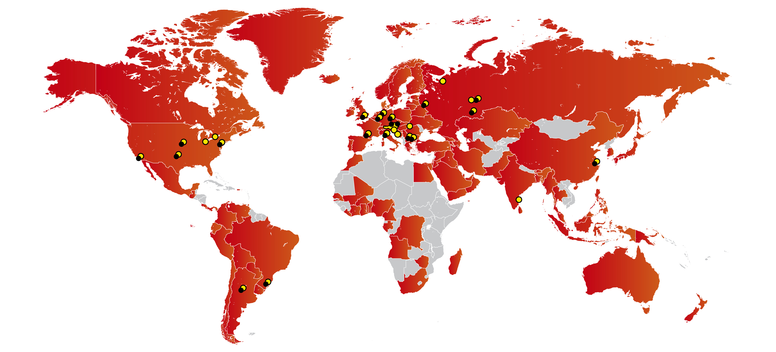
GLOBAL FOOTPRINT – IN SALES, SERVICE,
PRODUCT DEVELOPMENT AND VALUE CREATION
20 R&D centres
31 production sites LAND
5,000 service centres
(approx. 10,000 service staff / of which approx. 700 PALFINGER)
8

Slide 9
HIGHLIGHTS LAND SEGMENT
Growth based on significant expansion of business in EMEA,
revenue increased by 10.0% to EUR 687.0 million
  Strong demand in EMEA in particular in construction, infrastructure and forestry
  High volume of incoming orders leads to bottlenecks in the supply of externally manufactured components
  Restructuring measures in North America completed to a major extent
  in the first half of 2018
  Good partnership with SANY as foundation for growth of the Sany Palfinger joint venture
  by around 30%
  Additional growth despite challenging environment in Russia/CIS
  Market environment in South America remains challenging, downturn has bottomed out
9

Slide 10
SEA SEGMENT
10

Slide 11
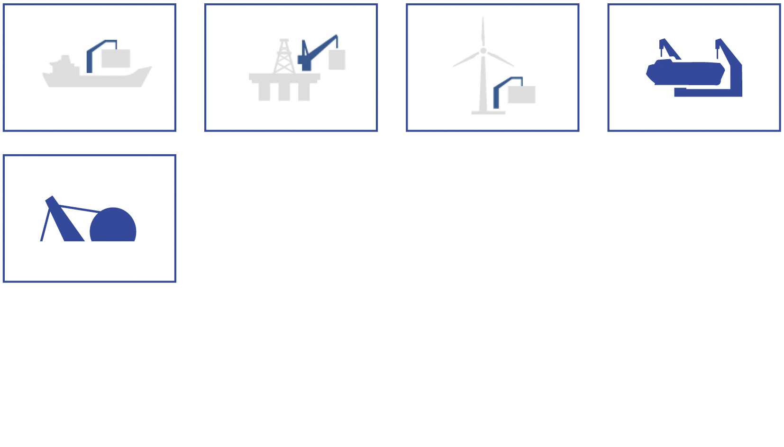
PRODUCT PORTFOLIO SEA SEGMENT
PALFINGER MARINE is the leading manufacturer of high-end deck equipment in the maritime sector
Marine cranes
Offshore cranes
Wind cranes
Lifesaving equipment
Winches & handling solutions
11

Slide 12
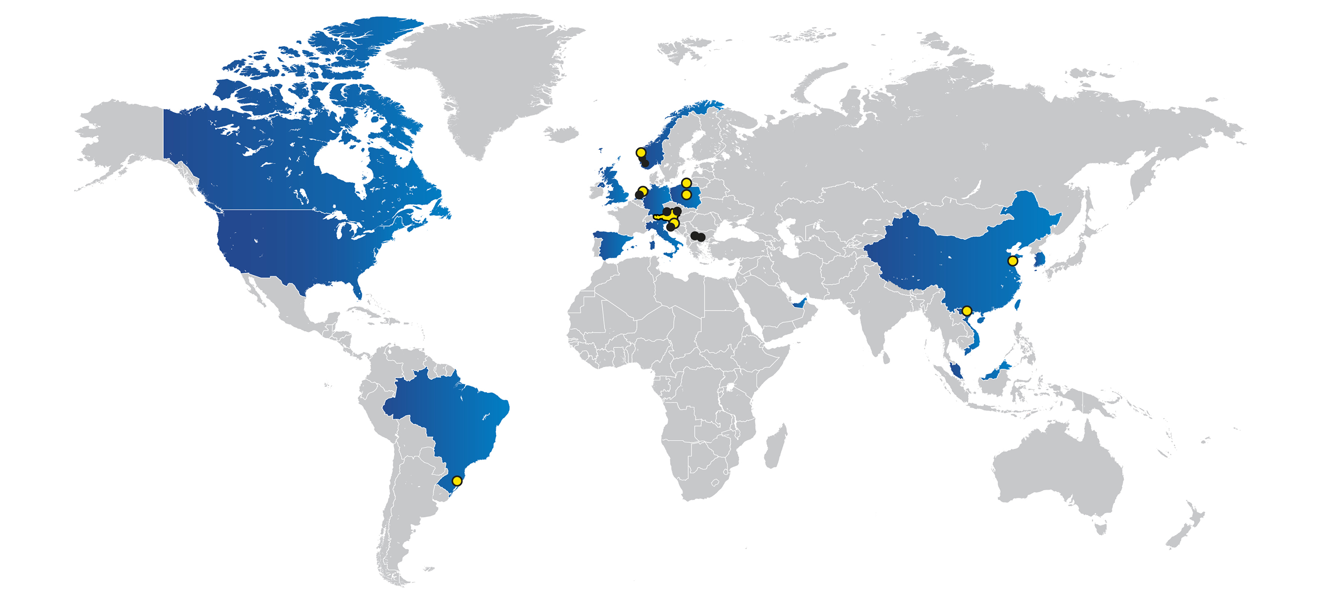
GLOBAL FOOTPRINT – IN SALES, SERVICE,
PRODUCT DEVELOPMENT AND VALUE CREATION
8 R&D centres
8 production sites SEA
26 service centres
(approx. 300 PALFINGER service staff)
12

Slide 13
HIGHLIGHTS SEA SEGMENT
Restructuring in full swing
  Revenue decreased by 11.0% to EUR 114.9 million
  Share of segment revenue in consolidated revenue thus shrank from 17.1% to 14.3%
  Business environment still difficult due to strained situation in the oil and gas industry
  For now, increase in oil price has positive impact on service business only
  Further evaluation of additional potential for increased earnings
13

Slide 14
KEY FINANCIALS
15

Slide 15
KEY FINANCIALS OF THE PALFINGER GROUP
 | HY1 2016 | HY1 2017 | HY1 2018 | %
Revenue | 665.6 | 753.8 | 801.9 | +6.4%
EBITDAn¹⁾ | 93.2 | 105.5 | 110.0 | +4.3%
EBITDAn margin¹⁾ | 14.0% | 14.0% | 13.7% | –
EBITn¹⁾ | 71.4 | 77.1 | 83.5 | +8.3%
EBITn margin¹⁾ | 10.7% | 10.2% | 10.4% | –
EBIT | 64.9 | 66.8 | 71.0 | +6.3%
Consolidated net result for the period | 39.7 | 38.6 | 35.2 | (8.8%)
1) Figures normalized (n) by restructuring costs.
Acc. to IFRS in EUR million. Minor rounding differences may occur.
15

Slide 16
RETURN ON CAPITAL EMPLOYED
1)
1,104
HY1 2014
HY1 2015
HY1 2016
HY1 2017
HY1 2018
Increase in ROCE due to optimized capital employment
1) Average of the previous 12 months.
Acc. to IFRS in EUR million. Minor rounding differences may occur.
19

Slide 17
INVESTMENTS
Enlargement of production capacities and replacement investments
1) Adjusted by acquisition of interest in SANY, total: EUR 145.6 million
Acc. to IFRS in EUR million. Minor rounding differences may occur.
17

Slide 18
GEARING RATIO AND EQUITY
Substantial improvement of balance sheet structure
Acc. to IFRS in EUR million. Minor rounding differences may occur.
18

Slide 19
FINANCING STRUCTURE AS AT 30 JUNE 2018
Financial liabilities (FL) | EUR 579.8m
Ø Interest rate FL | 1.75%
Ø Remaining time to maturity FL | 3.52 years
Cash equivalents | EUR 28.4m
Net debt | EUR 520.0m
Equity ratio | 37.2%
Gearing | 86.9%
Net debt/EBITDA | 2.97
Maturity
Acc. to IFRS in EUR million. Minor rounding differences may occur.
19

Slide 20
OUTLOOK
24

Slide 21
OUTLOOK AND OBJECTIVES
Continued increase in incoming orders gives reason to expect further positive business development and operating profitability
Restructuring measures in the marine business will affect earnings
in 2018 and 2019
Group-wide initiatives with a focus on internal synergies, process optimization, organizational streamlining and digital transformation (PALFINGER 21st,
Process Excellence)
Integration of all acquired companies
Incorporation of vision and strategy throughout the Group
2018: Increases in revenue and operating profitability expected
21

Slide 22
INVESTOR RELATIONS
Andreas Klauser, CEO
Phone +43 662 2281-81001
a.klauser@palfinger.com
Hannes Roither, Company Spokesperson
Phone +43 662 2281-81100
h.roither@palfinger.com
PALFINGER AG
Lamprechtshausener Bundesstrasse 8
5101 Bergheim
www.palfinger.ag
This presentation contains forward-looking statements made on the basis of all information available at the time of preparation of this presentation. Actual outcomes and results may be different from those predicted.
22

