Slide 1
INVESTOR PRESENTATION
05 // 2017

Slide 2










FACC AG – at a glance
100% focus on
lightweight
4 plants & 5 engineering
centers in Austria & Abroad
EUR 710 mill.
of revenues
Global network
TIER 1 partner to the
leading aerospace OEM‘s
3,400 employees
worldwide
Page 2

Slide 3
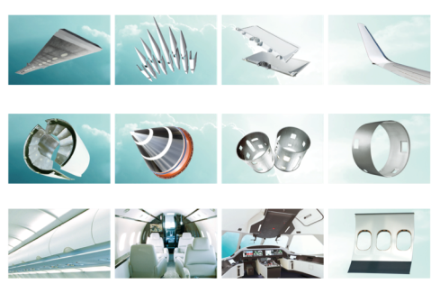

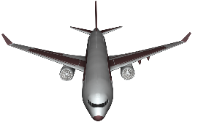
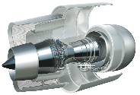

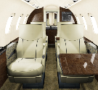
FACC activities are focused…
…on a defined product portfolio from the product idea to customer tailored solutions
AEROSTRUCTURES
ENGINES & NACELLES
INTERIORS

Slide 4
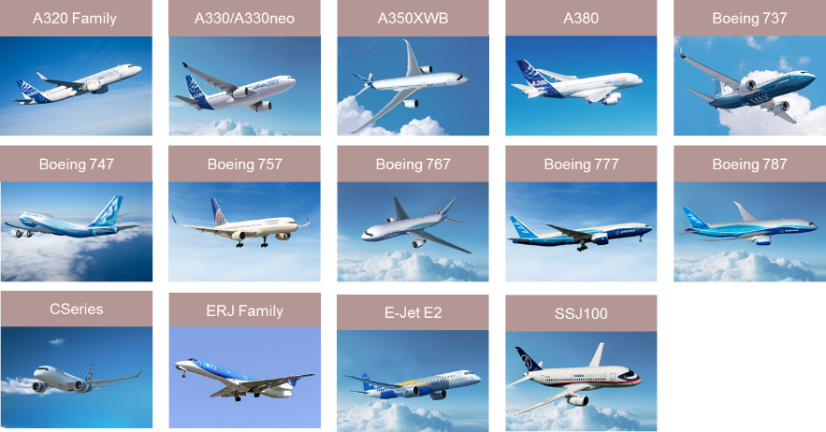
Program portfolio (1)
.. we supply products for all modern aircraft models in a single source environment
CIVIL AEROSPACE

Slide 5
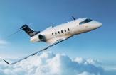



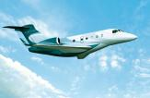
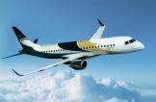
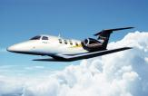

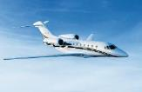
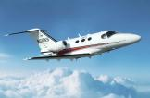
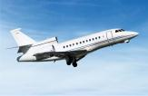
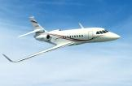
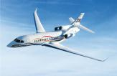

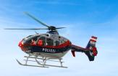
Program portfolio (2)
.. Interior-, Aerostructures- and Engine application for Business Jet’s
BUSINESS JETS & HELICOPTER
Challenger 350
Learjet 40/45
Global 5000
Global 7000/8000
Legacy 450/500
Lineage 1000E
Phenom 100/300
Gulfstream G350/
450/550/650
Cessna Citation
Cessna Mustang
Falcon 900
Falcon 2000
Falcon 7X
Hawker 800
EC135/EC145

Slide 6

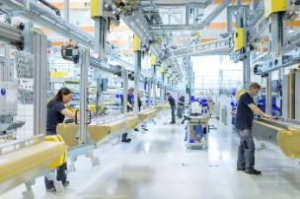
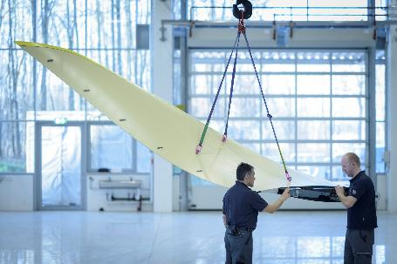
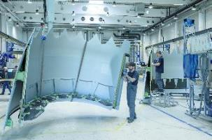
From Austria to the world
Global engineering and production footprint to meet customers’ needs worldwide
FACC Montreal (Canada)
FACC AG (Austria)
FACC Slovakia (Slovakia)
BTC (China)
Fesher (China)
Manufacturing/Engineering
Engineering
FACC Germany (Germany)
International supply chain partners
FACC India (India)
FACC Wichita (US)
Mubadala (Abu Dhabi)
TAML (India)
ACM (Malaysia)

Slide 7

1
FACC Company Overview
The Aerospace Market
Business Development & Strategy
Financials & Outlook
2
3
4

Slide 8

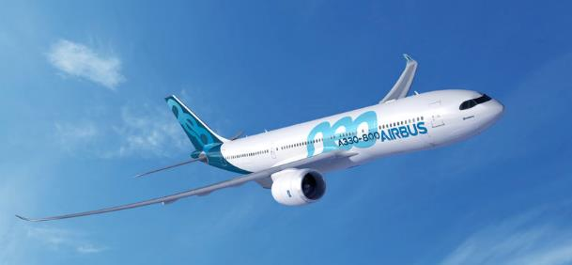
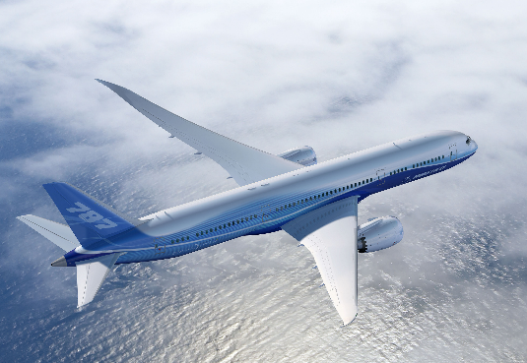
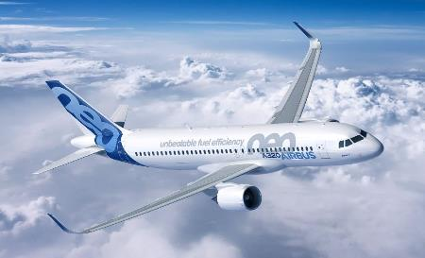
The Aerospace Market – Overview
Strong ramp up of the AIRBUS A350 program with a factor of 3,5
Narrow Body Airplanes continue with ramp up’s performing as scheduled
7-8 year firm order backlog at our customer and therefore at FACC
Book to bill ratio around 1 for both AIRBUS and BOEING
Business Jet order intake temporary below last years volume

Slide 9
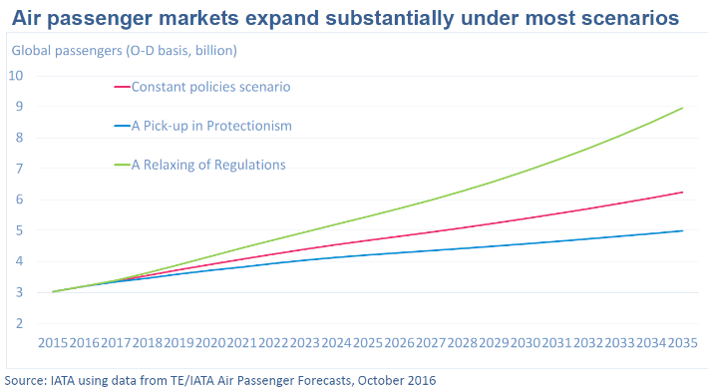
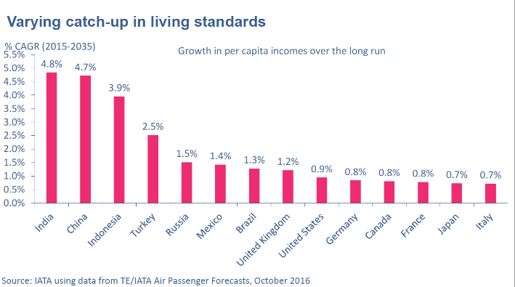
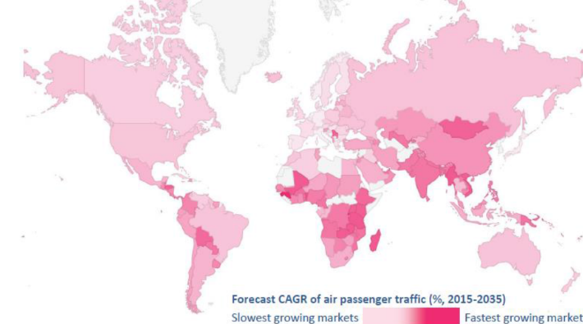

Forecast 2035 // Aerospace market
International Air Transport Association (IATA) – October 2016
Source: http://www.iata.org/whatwedo/Documents/economics/Presentations/WPS-BP-Dubai-Oct-2016.pdf

Slide 10
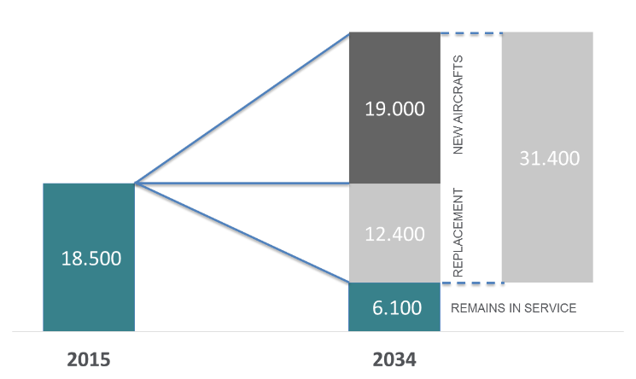
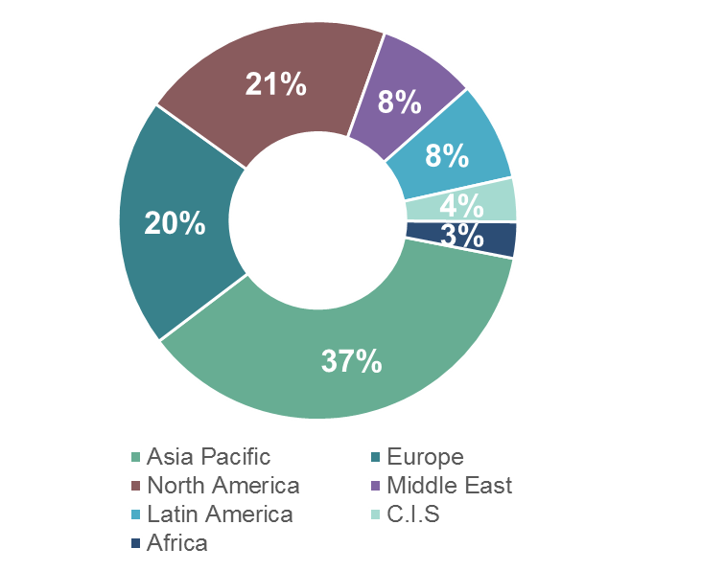
The Aerospace Market – Overview
…. FACC is well positioned in the market with its customer contracts but also with its main-shareholder AVIC
> 5% YoY market growth confirmed
FACC benefits from market growth - long term contracts with A350, A320 Neo, B787 are ramping up.
Markets with most growing demand are part of our global network (India, Abu Dhabi, China)
400 new airports are under construction worldwide
China by itself is setting up 98 new airports

Slide 11
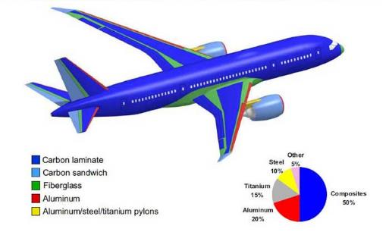
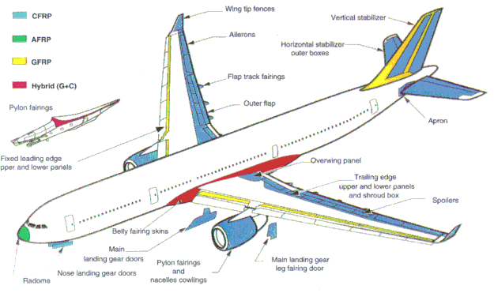
Lightweight Application Road Map
A swift change in composite application helps to improve aircraft efficiency. Composite demand is growing faster then passenger growth.
Past
Today
Mainly Secondary Structure
Fairings, Flight Control Surfaces & Interior
Limited application on primary structure
Primary structures made of composite
Technology step up mainly driven by automated composite production
Material & Process not significantly changed

Slide 12





Growing composite demand in airplanes
Changes in air travel and airline demands triggers development of more efficient products
From a 3% composite content on a 1970’s built B737’s to more than 50% composite content on last technology airplanes like A350 or B787
The A350 & B787 are step changing the Industry
High degree of automated production
Significant content of primary structure made out of composite

Slide 13
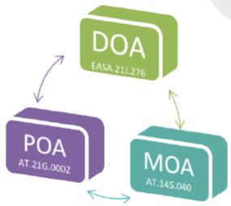



MRO business & design services
MRO activities to enhance our product & service portfolio
Significant fleet growth until 2035
Steadily increasing composite material share on new aircrafts requires different approach to aircraft maintenance and overhaul
High demand on cost-efficient repair designs, cabin upgrades, refurbishments and conversions requested from Airlines
FACC benefits rom its original part manufacturing know how can offer faster turn around time with quality and performance.
FACC CURRENT PROJECTS
A320 Cabin Retrofit for 110 Aircraft
A330 Cabin Conversion & Winglet
A320 Classic Cabin with Bigger Doors – 2.000 AC market
Retrofit campaigns with OEMs and operators
Test witnessing on various projects

Slide 14
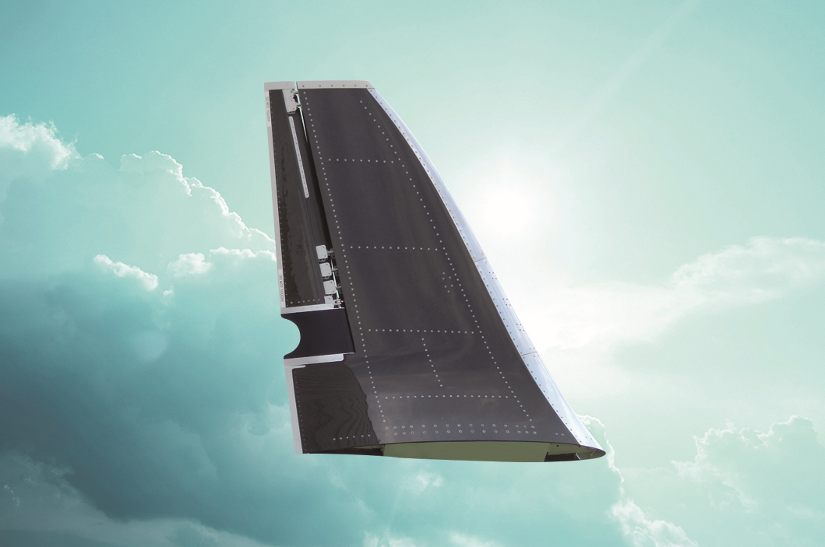
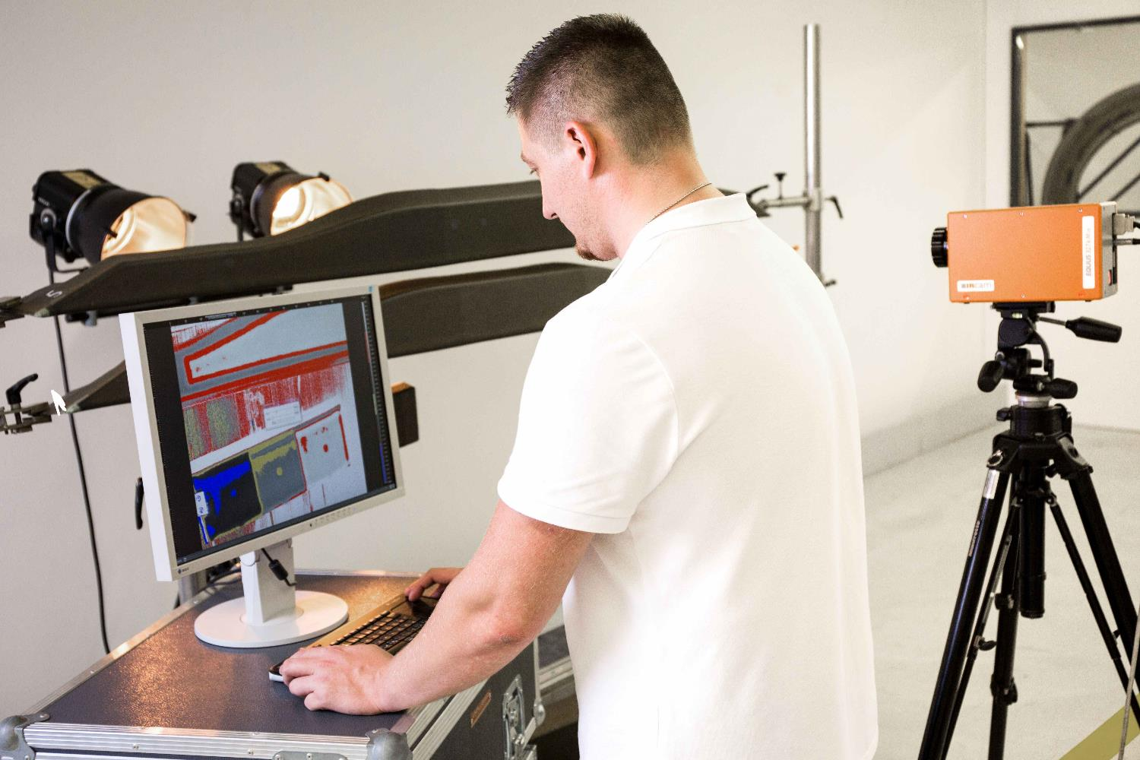
FACC Innovation with 240 Patents
… over 350 experienced Aerospace engineers work on innovation. 12 R&D engineers are assigned on next generation technology development.
Morphing Surfaces FACC drives the development of morphing structures technology, parts that are adopting to the mission profile.
I 4.0 / Thermography Inspection A revolutionary inspection system from FACC. FACC is the only Boeing qualified company “worldwide” for use of thermography in series production.
Next generation Composite Production With FACC’s patented membrane-assisted resin infusion (MARI) process, composites can be manufactured 50% faster. On top of that, it helps save 5-10% in weight.
Material & Process Engineering We are engaged with one OEM to develop composite material and process allowing the economical mass production (>100.000 p.a.) of composites parts. First application is used for a light weight aerospace seats.

Slide 15
1
FACC Company Overview
The Aerospace Market
Business Development & Strategy
Financials & Outlook
2
3
4

Slide 16

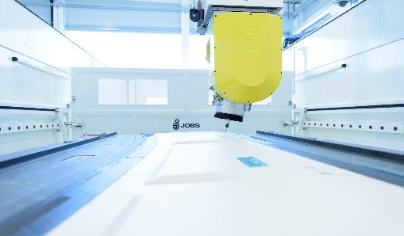
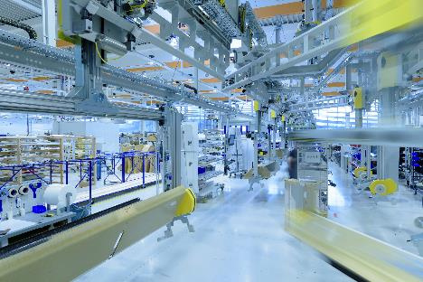
Current Situation and Solutions
FACC is well positioned to fulfill its stakeholder commitments for growth, profitability, financial strength and stability. We approach improvements in three phases.
Phase …
…Leading to
Stabilized Business
Secure commitment to Stakeholders
Stabilize performance & EBIT
Positive Cash Flow
Shareholder value commitment
18 Month Short Term
Commitment to execute Vision 2020
EUR 1 Billion Sales
Profitable & step change in EBIT
Extend global footprint
3 Year Mid Term
Develop company above 1 Billion
Enhance position as Tier 1 Partner
Global acting technology leader
2020+ Long Term

Slide 17
Deliveries, Milestones & Order Book
Ramp up of new programs as planned
Program development milestones executed as planned
AIRBUS A350-1000 deliveries
AIRBUS A330neo deliveries
Embraer E2 first part qualification
COMAC C919 certification milestones
500th shipsets of BOEING B787 product delivered to customers
Order book 2016/17 shows EUR 700 mill. revenue
Innovation and technology milestones

Slide 18
1
FACC Company Overview
The Aerospace Market
Business Development & Strategy
Financials & Outlook
2
3
4

Slide 19
Preliminary results 2016/17
Continuous growth and earnings improvement
SALES
EBIT ¹⁾
NET DEBT/EBITDA ¹⁾
EUR mill.
1) EBIT and EBITDA for the business year 2015/16 are exluding on off costs in connection with the FAKE PRESIDENT INCIDENT of EUR 41,9 mill.

Slide 20
Preliminary results 2016/17
Continuous growth and earnings improvement
Quarterly earnings development 2015/16 – 2016/17
EUR mill.

Slide 21
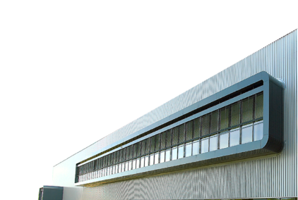
Executive Summary
Air traffic will double in size up to 2034 an require 32.000 new airplane
FACC is well positioned in the Aerospace market
Producing for all major OEM platforms
New product portfolio with up to 20 years contract terms
Global network established and footprint in growing regions
150 million EUR organic growth lined up based on today’s market forecast
A350 production output increasing
B787 demand increasing in steps between 20% and 40%
Narrow Body production output (A320 & B737) increases by 50%
Production ramp for C-Series ongoing
Technology Innovation lined up for next generation airplanes
Execution of performance measures ongoing

Slide 22
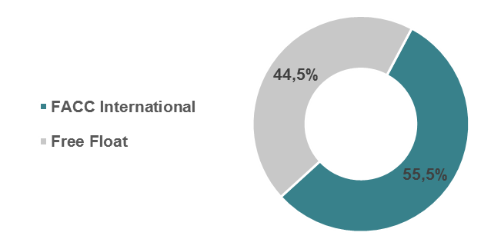
IR-Information
Share Information
IR Contact
ISIN | AT00000FACC2
Official Market | Vienna Stock Exchange / prime-market
Ticker Symbol | FACC
Reuters | FACC.VI
Bloomberg | FACC AV
Shares Outstanding | 45,790,000
Market Capitalisation | ~ 270 EUR mill.
Manuel Taverne
Director Investor Relations
Phone: +43/59/616-2819
Mobile: +43/664/80119 2819
e-mail: m.taverne@facc.com­
Shareholder Structure

